Slide 1

EXAM SURVEILLANCE SYSTEM
TEAM: AIB HACKS
OMKAR MANE | ADVAIT NAIK | ADITYA GURNANI
KRISH AMESUR | TEJAS DHOPAVKAR

Slide 2
PROBLEM STATEMENT
A live video monitoring system to track students activity during online/offline examination and to get a clear view of each student in the frame and to record their attendance using face recognition and to classify student’s activity as suspicious or normal based on head movement and body movement. These recordings can be played back for future references.

Slide 3
WHY THIS PROJECT?
Trying times due to COVID-19
Online/Offline examinations
A mechanism to check unfair means during examinations

Slide 4
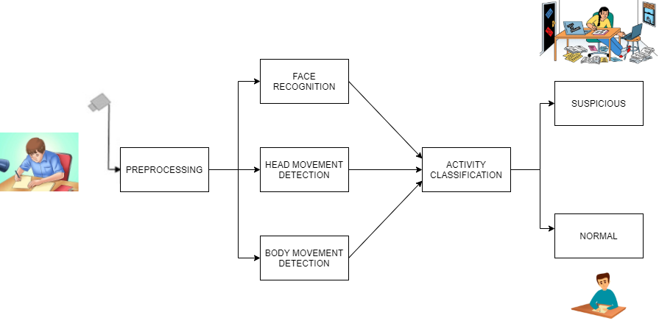
SYSTEM ARCHITECTURE
🔷STAGE 1 | 🔷STAGE 2 | 🔷STAGE 3 | 🔷 STAGE 4 | 🔷STAGE 5

Slide 5

TECH STACK
OPENCV
TENSORFLOW
KERAS
TKINTER
FACE RECOGNITION
PYTHON

Slide 6
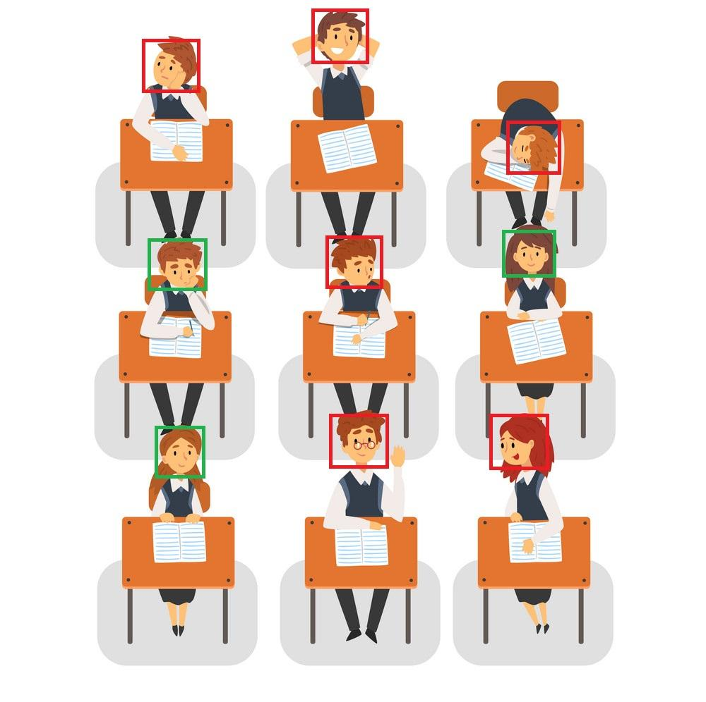
SOLUTION (1 of 2)
Face recognition for marking student’s attendance even if a student is wearing a mask considering current situation.
Tracks the activity of students appearing for the exams.
System will note their actions.
System will categorize the activity into suspicious activity or normal activity.

Slide 7

SOLUTION (2 of 2)
Suspicious activity will denote that the student is resorting malpractices while giving the exam.
The system will detect if a student is peeping into some other student’s paper or a book constantly during online offline examination and then give a warning.
If maximum number of warnings are surpassed, student will be blacklisted.

Slide 8
REFERENCES
https://www.ncbi.nlm.nih.gov/pmc/articles/PMC4839304/
https://www.frontiersin.org/articles/10.3389/fict.2015.00021/full
https://sci-hub.tw/10.1007/978-981-10-0251-9_11
https://medium.com/@chataks93/predicting-human-behaviour-activity-using-deep-learning-lstm-fff9030b82e7
https://www.tribuneindia.com/news/nation/coronavirus-drdo-developing-ai-based-face-recognition-system-for-marking-attendance-87420
https://ieeexplore.ieee.org/document/8697824

Slide 9
THANK YOU!

